Slide 1


Slide 2

Paper CS780
Multimodal Emotion Recognition via
Ensemble and Learned Fusion Strategies
Author: Wee Ling Hue, Ho Chuk Fong, Goh Ching Pang
Tunku Abdul Rahman University of Management and Technology (TAR UMT)
Kuala Lumpur, Malaysia
Presenter: Ho Chuk Fong
Notes:
intro [1m]
problem [2m]
related work [2m]
methodology [3m]
result and discussion [3m]
future work [1m]
12 min [PPT]
3 min [Q&A]

Slide 3
Introduction

Slide 4

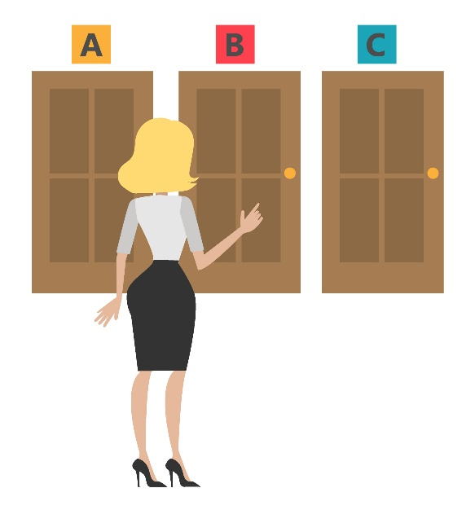

Emotion
"Emotion is a complex pattern of reactions involving
behavioral, physiological, and experiential components."
Social relationships
Communication
Decision-making
Notes:
intro [1m]
problem [2m]
related work [2m]
methodology [3m]
result and discussion [3m]
future work [1m]
12 min [PPT]
3 min [Q&A]

Slide 5



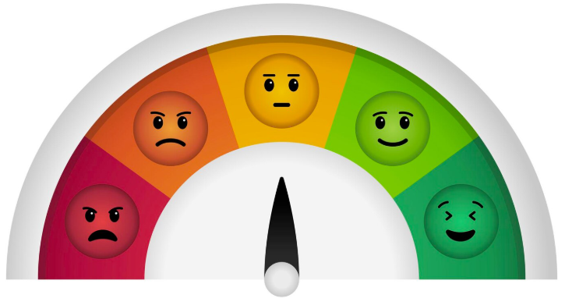


Emotion Recognition
"Emotion recognition is the process of identifying a person's
emotional state in response to specific events or situations."
Where did you go yesterday? I waited for you for a long time. I don't think it was nice of you to not wait for me.
Emotion Model
Notes:
intro [1m]
problem [2m]
related work [2m]
methodology [3m]
result and discussion [3m]
future work [1m]
12 min [PPT]
3 min [Q&A]

Slide 6
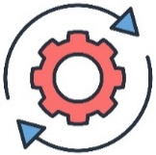


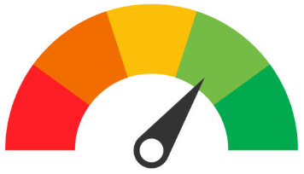





Categories of Emotion Recognition Model
Modality
Training
Models
Testing
Prediction
Text-based
Written Text
Happy
Audio-based
Speech Pattern
Happy
Visual-based
Facial Expression
Happy
Notes:
intro [1m]
problem [2m]
related work [2m]
methodology [3m]
result and discussion [3m]
future work [1m]
12 min [PPT]
3 min [Q&A]

Slide 7



Single Modality Approach
Many emotion recognition systems are trained on single-modality, limiting modal performance.
Happy
Happy
Happy
Notes:
intro [1m]
problem [2m]
related work [2m]
methodology [3m]
result and discussion [3m]
future work [1m]
12 min [PPT]
3 min [Q&A]

Slide 8




Multimodal Approach
I love the birthday present so much! Thank you!
Linguistic context
Vocal context
Visual context
Notes:
intro [1m]
problem [2m]
related work [2m]
methodology [3m]
result and discussion [3m]
future work [1m]
12 min [PPT]
3 min [Q&A]

Slide 9
Multimodal Approach
I love the birthday present so much! Thank you!
Linguistic context
Multimodal Emotion Recognition Model
Vocal context
Visual context
Notes:
intro [1m]
problem [2m]
related work [2m]
methodology [3m]
result and discussion [3m]
future work [1m]
12 min [PPT]
3 min [Q&A]

Slide 10
Ensemble Methods
Noise
Reduction
Enhanced Generalizability
Linguistic context
Hard Voting
Ensemble Methods
Soft Voting
Vocal context
Stacking
Visual context
AdaBoost*
*AdaBoost ➔ Adaptive Boosting
Notes:
intro [1m]
problem [2m]
related work [2m]
methodology [3m]
result and discussion [3m]
future work [1m]
12 min [PPT]
3 min [Q&A]

Slide 11
Investigation
Single Modality Approach
To compare the performance of single-modality emotion recognition models.
Multimodal Approach
To examine the performance of multimodal emotion recognition models.
Ensemble Methods
To assess the effectiveness of ensemble methods for combining multimodal data.
Notes:
intro [1m]
problem [2m]
related work [2m]
methodology [3m]
result and discussion [3m]
future work [1m]
12 min [PPT]
3 min [Q&A]

Slide 12
Related Work

Slide 13


Previous Studies: Single Modality Approach
Ref. | Modality | Method | Metric | Result
[19] | Text-based | Traditional ML | Accuracy | 0.6408
[20] | Text-based | DL | F1-score | 0.9060
[21] | Text-based | DL | ROC-AUC | 0.9900
[23] | Audio-based | DL | Accuracy | 0.9747
[24] | Audio-based | DL | Accuracy | 0.9948
[25] | Visual-based | DL | Accuracy | 0.6620
[26] | Visual-based | DL | Accuracy | 0.9850
[27] | Visual-based | DL | Accuracy | 0.9600
?
Sarcasm
Speaker Variability
Subtle
Facial Expression
Notes:
intro [1m]
problem [2m]
related work [2m]
methodology [3m]
result and discussion [3m]
future work [1m]
12 min [PPT]
3 min [Q&A]

Slide 14

Previous Studies: Multimodal Approach
Ref. | Modalities | Method | Metric | Result
[28] | Text, audio and visual | DL | Accuracy | 0.8270 (IEMOCAP) 0.8900 (CMU-MOSEI)
[29] | Physiological signals and visual | ML | Accuracy | 0.8096
[30] | Audio and visual | DL | Accuracy | 0.8329
Single Modality vs. Multimodal
Notes:
intro [1m]
problem [2m]
related work [2m]
methodology [3m]
result and discussion [3m]
future work [1m]
12 min [PPT]
3 min [Q&A]

Slide 15
Previous Studies: Ensemble Methods
Ref. | Modality | Method | Metric | Result
[31] | Audio and visual | Hard Voting | Accuracy | 0.8419
[32] | Text and audio | Hard Voting | F1-score | 0.4747
[33] | Text, audio and visual | Soft Voting | Accuracy | 0.8825
[34] | Text and visual | Stacking | Accuracy | 0.4529 (multiclass classification) 0.8400 (binary classification)
[35] | Text, Musical Instrument Digital Interface (MIDI) and audio | AdaBoost | Accuracy | 0.724
Some ensemble methods
show promising results…
Notes:
intro [1m]
problem [2m]
related work [2m]
methodology [3m]
result and discussion [3m]
future work [1m]
12 min [PPT]
3 min [Q&A]

Slide 16
Research Methodology

Slide 17
Research Methodology
1
2
3
Single Modality
Multimodality
Fusion
Text, Audio and Visual-based Modality
Bimodal vs. Trimodal Combination
Ensemble Methods
Notes:
intro [1m]
problem [2m]
related work [2m]
methodology [3m]
result and discussion [3m]
future work [1m]
12 min [PPT]
3 min [Q&A]

Slide 18
Research Methodology
Data Collection
Model
Training
Model Evaluation
1
2
3
4
5
Data
Splitting
Model
Fine-Tuning
Notes:
intro [1m]
problem [2m]
related work [2m]
methodology [3m]
result and discussion [3m]
future work [1m]
12 min [PPT]
3 min [Q&A]

Slide 19

Data Collection
The Interactive Emotional Dyadic Motion Capture (IEMOCAP) dataset
Created by the Speech Analysis and Interpretation Laboratory (SAIL) at the University of Southern California (USC)
Includes video, speech, facial motion-capture data, and text transcripts.
IEMOCAP Dataset
A preprocessed version¹ with features pre-extracted.
Six (6) categories of emotion:
  Neutral, Sad, Excited, Happy, Frustrated and Angry
1 https://www.kaggle.com/datasets/columbine/iemocap/data
Notes:
intro [1m]
problem [2m]
related work [2m]
methodology [3m]
result and discussion [3m]
future work [1m]
12 min [PPT]
3 min [Q&A]

Slide 20
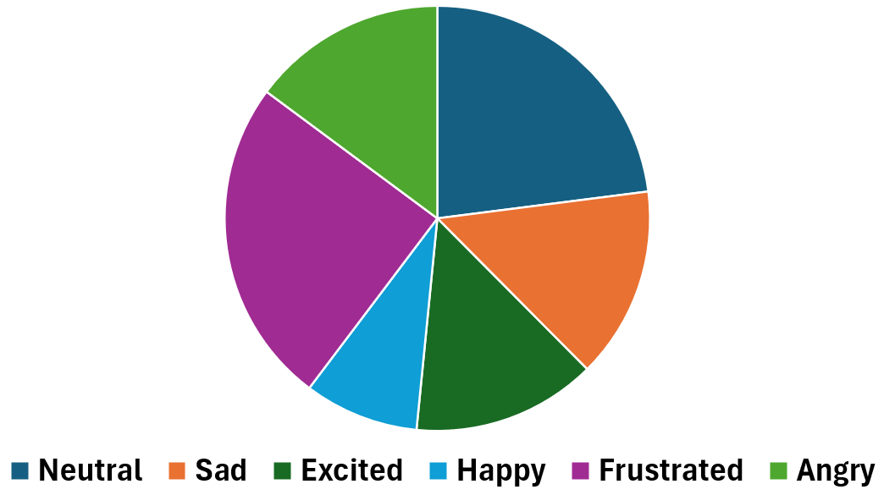
Stratified 5-Fold Cross Validation
Stable & unbiased performance
Preserved class distribution
Stratified 5-Fold CV
20%
20%
20%
20%
20%
E.g., Frustrated > Neutral > Happy
Notes:
intro [1m]
problem [2m]
related work [2m]
methodology [3m]
result and discussion [3m]
future work [1m]
12 min [PPT]
3 min [Q&A]

Slide 21



Model Training, Fine-Tuning and Evaluation
Hyperparameter Optimization
Averaged Accuracy
Grid Search
BERT
CNN-LSTM
Averaged F1-Score
GRU
LSTM
20%
20%
20%
20%
20%
MLP
ResCNN
Accuracy
F1-Score
Notes:
intro [1m]
problem [2m]
related work [2m]
methodology [3m]
result and discussion [3m]
future work [1m]
12 min [PPT]
3 min [Q&A]

Slide 22
Results and Discussion

Slide 23

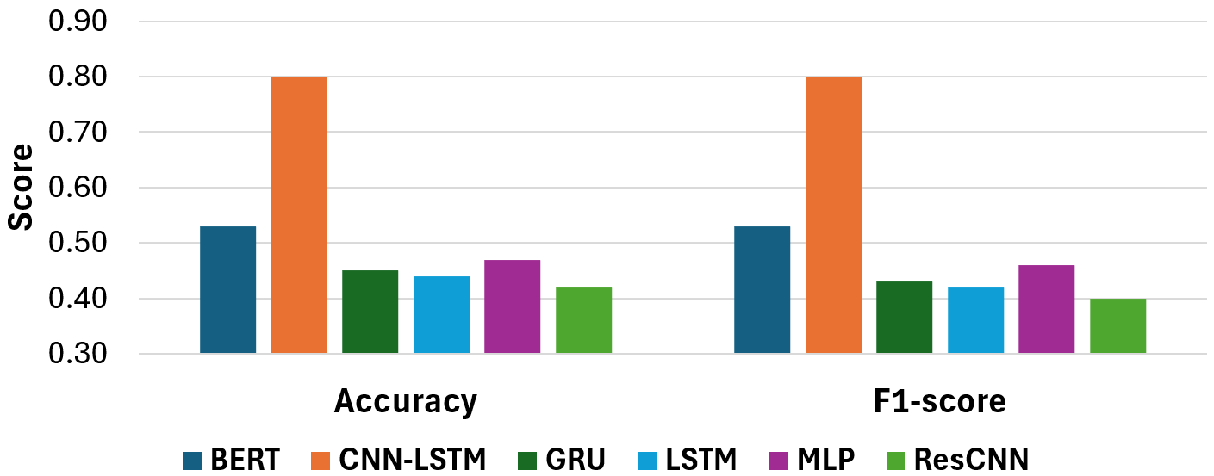
Comparison of Single-Modality Models
Notes:
intro [1m]
problem [2m]
related work [2m]
methodology [3m]
result and discussion [3m]
future work [1m]
12 min [PPT]
3 min [Q&A]

Slide 24
Comparison of Single-Modality Models
BERT may work better as an embedding generator.
Notes:
intro [1m]
problem [2m]
related work [2m]
methodology [3m]
result and discussion [3m]
future work [1m]
12 min [PPT]
3 min [Q&A]

Slide 25

Comparison of Single-Modality Models
Text is the most informative modality for emotion recognition.
Notes:
intro [1m]
problem [2m]
related work [2m]
methodology [3m]
result and discussion [3m]
future work [1m]
12 min [PPT]
3 min [Q&A]

Slide 26
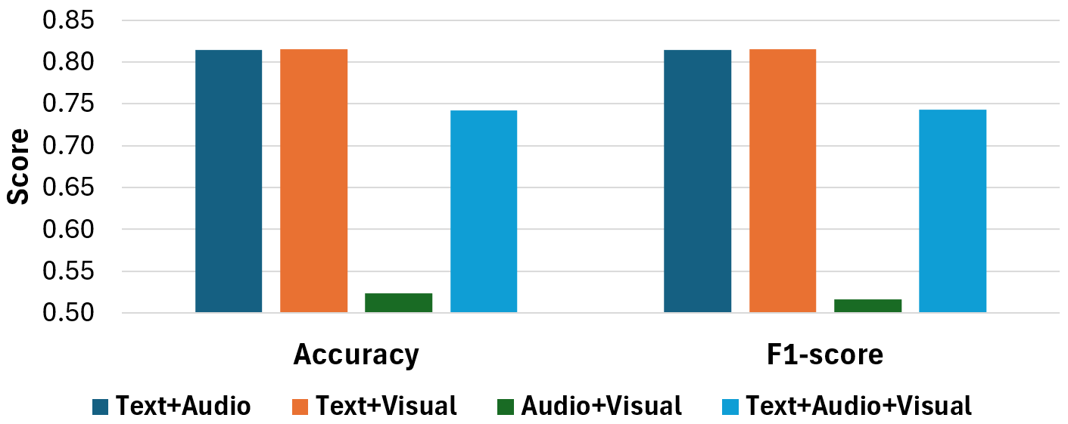
Comparison of Multimodal Models (Hard Voting)
Text-only Baseline
Text-only Baseline
Notes:
intro [1m]
problem [2m]
related work [2m]
methodology [3m]
result and discussion [3m]
future work [1m]
12 min [PPT]
3 min [Q&A]

Slide 27
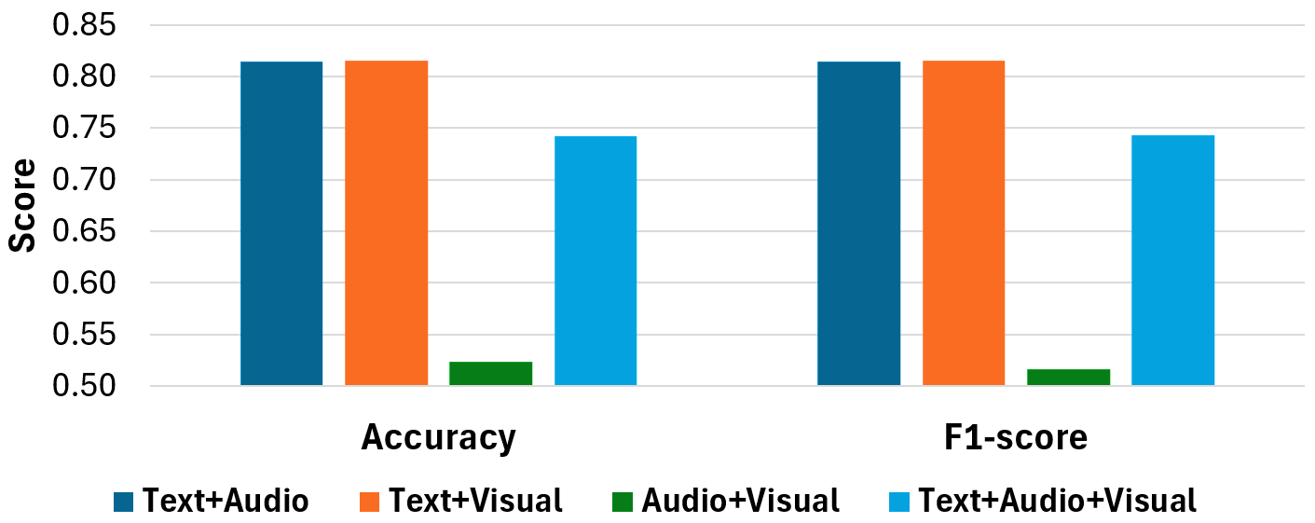
Limitation of Hard Voting
Text-only Baseline
46%
26%
28%
Contribution analysis reveals that text is the most informative modality but hard voting assigns equal weight to all modalities.
Notes:
intro [1m]
problem [2m]
related work [2m]
methodology [3m]
result and discussion [3m]
future work [1m]
12 min [PPT]
3 min [Q&A]

Slide 28
Comparison of Ensemble Methods
Score | Combination | Hard Voting | Soft Voting | Stacking | AdaBoost
Accuracy | Text+Audio | 0.8143 | 0.8242 | 0.8244 | 0.8135
 | Text+Visual | 0.8149 | 0.8239 | 0.8230 | 0.8151
 | Audio+Visual | 0.5232 | 0.5360 | 0.5484 | 0.5244
 | Text+Audio+Visual | 0.7421 | 0.8322 | 0.8363 | 0.8212
F1-score | Text+Audio | 0.8143 | 0.8243 | 0.8246 | 0.8136
 | Text+Visual | 0.8149 | 0.8240 | 0.8232 | 0.8152
 | Audio+Visual | 0.5163 | 0.5254 | 0.5454 | 0.5212
 | Text+Audio+Visual | 0.7427 | 0.8323 | 0.8365 | 0.8211
Notes:
intro [1m]
problem [2m]
related work [2m]
methodology [3m]
result and discussion [3m]
future work [1m]
12 min [PPT]
3 min [Q&A]

Slide 29
Comparison of Ensemble Methods
Score | Combination | Hard Voting | Soft Voting | Stacking | AdaBoost
Accuracy | Text+Audio | 0.8143 | 0.8242 | 0.8244 | 0.8135
 | Text+Visual | 0.8149 | 0.8239 | 0.8230 | 0.8151
 | Audio+Visual | 0.5232 | 0.5360 | 0.5484 | 0.5244
 | Text+Audio+Visual | 0.7421 | 0.8322 | 0.8363 | 0.8212
F1-score | Text+Audio | 0.8143 | 0.8243 | 0.8246 | 0.8136
 | Text+Visual | 0.8149 | 0.8240 | 0.8232 | 0.8152
 | Audio+Visual | 0.5163 | 0.5254 | 0.5454 | 0.5212
 | Text+Audio+Visual | 0.7427 | 0.8323 | 0.8365 | 0.8211
Introducing complementary modalities to text can provide additional emotional cues, but this effect is influenced by the effectiveness of fusion.
Notes:
intro [1m]
problem [2m]
related work [2m]
methodology [3m]
result and discussion [3m]
future work [1m]
12 min [PPT]
3 min [Q&A]

Slide 30
Conclusion and Future Work

Slide 31
Conclusion
1. Text is the most informative modality.
2. Different modalities can improve performance when combined.
3. Multimodal inputs are useful, but they must be chosen carefully.
4. Hard voting is ineffective as the modalities contribute unequally.
5. Stacking is the most effective ensemble method.
Notes:
intro [1m]
problem [2m]
related work [2m]
methodology [3m]
result and discussion [3m]
future work [1m]
12 min [PPT]
3 min [Q&A]

Slide 32

Future Work
“More diverse datasets with natural emotional expressions”
“Advanced fusion strategies such as attention-based mechanisms, transformer-based architectures, or hybrid integration techniques”
Notes:
intro [1m]
problem [2m]
related work [2m]
methodology [3m]
result and discussion [3m]
future work [1m]
12 min [PPT]
3 min [Q&A]

Slide 33
Thank You!
Notes:
intro [1m]
problem [2m]
related work [2m]
methodology [3m]
result and discussion [3m]
future work [1m]
12 min [PPT]
3 min [Q&A]

